Slide 1


Anna Ly & Hain-Lee Hsueh

Slide 2
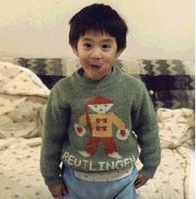

About Us
Hain-Lee Hsueh
Anna Ly
Background in ECE and Software Engineering from Cornell. Formally worked for Oracle Enterprise Applications.
Background in HCI, Business & Communication Design from Carnegie Mellon. Formally worked for IBM Strategy.
Notes:
We thank you all for coming and listening to our presentation.

Slide 3
Social Processing Machines
Notes:
[1:30]
First I wanted to draw everyone’s attention to the fact that we are social processing machines. What do I mean by this? Imagine a typical day where you walk into work in the morning and as always, you say hello to your coworker. But this particular time you immediately sense that your coworker seems a bit down, so you quickly change tone and say, “Hey, is everything all right?”
In order to recognize something was wrong, you needed to notice the person’s facial expression, general posture, tone of voice, perhaps even the state of her desk – and you were able to process all of those cues and instantaneously draw a conclusion about the person’s mental state. And after drawing this conclusion, you were able to immediately generate an appropriate reaction.
Where did we learn how to do this? Chances are we can’t explicitly trace back to when we learned these skills – most of us probably picked them up naturally from our daily interactions.
But what if we didn’t have these skills? How much more difficult would it be to participate in society if we didn’t have this natural ability for social processing? This is an issue that is very real for the learners that we developed our project for, namely people with autism or similar mental disorders.

Slide 4
Background
Autism and ASD
Affects 1 in 88 American children
# of yearly diagnoses
Autism > cancer + diabetes + pediatric AIDs
Problem
Children with autism struggle socially with:
Verbal/non-verbal communication
Emotional reciprocity
Social interactions
Notes:
[0:30]
Hain-Lee
Most of us probably have some idea of what autism is, but what we may not realize, however, is how common it is –according to statistics, autism affects 1 in 88 American children, and that the # of people diagnosed each year is more than cancer, diabetes, and pediatric AIDS combined.
Knowing that autism affects so many people, we wanted to do our project on helping them develop social skills, which is a common area of difficulty for them.

Slide 5
Refining the Learning Space
Emphasis on socio-emotional learning/thinking
Displaying feelings through facial expressions is not automatic
Learners may know what to do, but anxiety impedes execution
A common difficulty is understanding things from another’s perspective
Notes:
Anna
After interviews with primarily therapists and doing general research, we saw an emphasis on socio-emotional learning (recognizing, expressing, and understanding emotions). Perhaps this is because a cognitive emotional understanding may be fundamental to other social skills, such as perspective-taking and interpersonal communication (e.g. Social Thinking - citations)
Usually overexaggerate or underexaggerate so it is unnatural or unexpressive
Applications are angular and look robotic
Sandra: “One kid once came up really close to me (*stands up against another staff member to illustrate) and said, “It’s nice to meet you!” and I had to back away to let him know that he was standing too close.”
"Communication is a major problem...when I ask him a question, he often doesn't answer it and just says whatever happens to be on his mind at the moment."
Although they may know exactly what to do, communication in person especially to strangers is extremely hard
Kids sometimes get attached to negative feedback

Slide 6
Research
Empathy has two components (Baron-Cohen et al, 2009)
Cognitive: recognizing mental states
Affective: reacting appropriately
Some studies show that the cognitive component can be taught!
Limitations with behavioral approaches (Koegal & Koegal, 1995, Strain et. al, 2011, Schriebman, 2007, Luckett et. al, 2007)
Notes:
[1:00]
One prominent researcher in this area, Simon Baron-Cohen, framed empathy has having two components. There’s a cognitive component, which is the part where you’re able to recognize that your coworker is feeling sad. Then there’s the affective part where you react appropriately to your coworker’s mental state. From some of his studies, Baron-Cohen concluded that the cognitive component can be taught to individuals with autism, which is good, because it means our efforts in this project aren’t futile.
We also came across interventions that were behavioral in their approach, as well as criticisms of pure behaviorism for not fostering genuine social interaction. We ended up not adopting a dominant behavioral approach because it is most effective in specific behavior change, and we’re more concerned with a cognitive understanding.
---
National Research Council noted the most important areas of focus include: d) Instruction leading to generalization and maintenance of cognitive goals in natural contexts
Contemporary ABA researchers have criticized ABA approaches that use DTT and other adult–directed teaching as the predominant instructional method, citing its limited effectiveness. Their concerns include: 1) the use of teaching strategies that do not foster social communication, communicative initiation, or the formation of relationships, all of which are core challenges in autism; 2) a teaching format that is primarily adult-controlled and that discourages initiation and spontaneity in communication and learning by placing a child in a respondent role, resulting in passivity and prompt dependence; and 3) the teaching of skills that may not be appropriate to a child’s developmental level or functional needs, and that remain limited to the teaching situation; that is, they do not meaningfully generalize to independent use in daily interactions and activities. In fact, due to these concerns, several of the most well-respected and highly published researchers in ABA and ASD over the past three decades—including Drs. Robert and Lynn Koegel, Laura Schreibman, Phil Strain, and Gail McGee—have been openly critical of traditional ABA practices, and have abandoned such practices in favor of more naturalistic approaches that have a strong developmental and child-centered basis (Koegel & Koegel, 1995, Strain, McGee, & Kohler, 2001, Schreibman, 2007).
Do behavioural approaches teach children with autism to play or are they pretending?
Luckett T, Bundy A, Roberts J.
Source
The University of Sydney, Lidcombe, NSW, Australia. t.luckett@usyd.edu.au
Abstract
Play is, by definition, internally motivated, flexible, spontaneous and voluntary. Yet some researchers claim to have taught children with autism to play using behavioural interventions that are heavily structured, repetitive and make use of external reinforcements. In the current systematic review, we examine the extent to which these claims are supported by the evidence presented by the researchers themselves. We conclude that the most effective behavioural interventions have been those which have built on children's existing abilities or have relied on the motivating nature of activities themselves rather than on external rewards. We discuss the problems inherent in distinguishing between behavioural and cognitive change in children's play and highlight generalization as a poorly understood but focal process. Finally, we discuss the value of teaching children with autism play behaviours when these are not characterized by the defining qualities of play as a disposition.

Slide 7
Learning Problem
Target Learners
Children or adolescents with mild to moderate Autism
Learning Goal
Strengthen understanding of emotions to develop socio-emotional skills and behaviors
Notes:
Anna
Based on the research and interviews, we honed in on a target learner which is…..and the learning goal….
Mild to moderate implies that the children who use our system must be able to function at a minimum level. They may have severe language delays or lack refined motor skills but will need to have
At least have manageable control over his/her body. Common manifestations in children with autism include periods of time when they’re in their own little world as well as emphasis on fixed behaviors and routines, which sometimes translates to ritualistic behaviors
Originally we wanted to design something for interaction between multiple kids, perhaps more than 1 on the spectrum, but from interviews we decided to focus more on therapists and the work/activities they do with children on the spectrum. A couple also mentioned how difficult and complex it would be to have activities involving multiple children on the spectrum (e.g. most integrated play groups only have 1 child on the spectrum interacting with typically developing peers)

Slide 8
Two solutions
One-liner
Process
Walkthrough
Learner Studies
Feedback
Notes:
Hain-Lee
[0:30]
It’s best to look at our project not as one product, but as exploring two potential solutions on two different platforms within the same learning space. For each sub-project, we’ll cover a one-line description, the process of developing the idea, and what the current solution looks like.
After going through both of them, we’ll wrap up with learner study summaries and feedback.

Slide 9
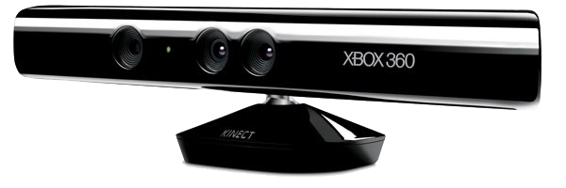
Me.Mu is a pair of mini-games on the Kinect that teaches greetings and facial emotions.
Notes:
PRACTICE THE AIM
Anna
Our aim is make Me.Mu a toolkit for therapists and educators so that different activities can appeal to children of different particular needs.

Slide 10
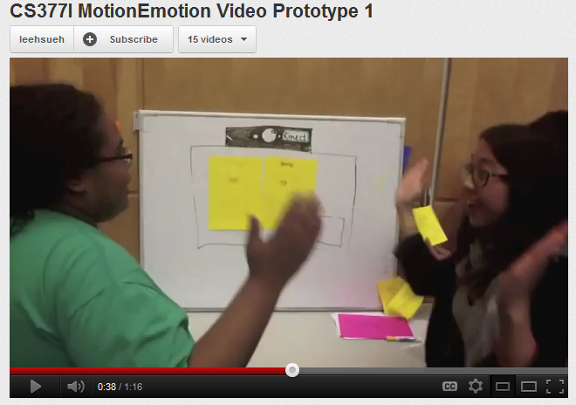
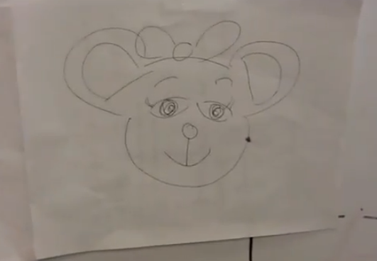
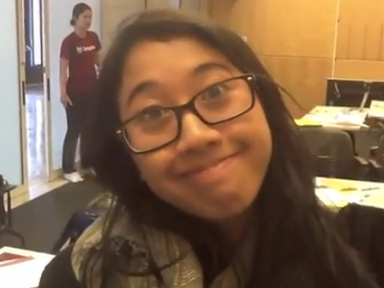
Initial Video Prototype
Notes:
PRACTICE PRACTICE PRACTICE
Anna
** That is what the current MeMu is but how it started out is completely different
We initially brainstormed lots of ideas but the first one we fleshed out was for the Kinect. Two players would participate by watching a cartoon scenario with two bears. At key events, the game would prompt one of the players to show how one of the bears feels at that moment. The player would respond by making the facial expression corresponding to the emotion. A key part of this idea was using the Kinect to perform facial emotion recognition. In addition to this, players could practice turn-taking and social interaction with the other peer.
http://www.youtube.com/watch?v=QC4-Bfd2wZk
Explain that facial recognition/tracking/emotion detection was a key component!!
** Toca boca example**
WALKTHROUGH RESULTS
Emphasis on realism – needs to be extremely salient to user so real faces instead of bears
Focus on empathy – emotion in context – Can’t be just straightforward mimicking; need to relate to situations they understand and put the emotions into context so they understand how to transfer it / See their face mimic the model face rather than just see the model face so they can monitor how well they match / Need to involve them more
Minimum level of cognitive functioning
Animations as a reward – Kids love animations so having it just as the reward is fun for them – or at least letting them take a picture of themselves
Variety of stories – Kids will get bored just from one story ; maybe have videos that the kids like themselves so Shaun the Sheep

Slide 11
Initial Video Prototype
Feedback
Needs to be more realistic
Focus on emotions in context
Notes:
We created a video prototype of this idea and shared it with a couple therapists. The main feedback we received from them was that it needed to be more realistic in order for the kids to take the perspective of another human being – “bears…who cares?”. Second, there needed to be more of an emphasis on context – showing a very simplistic and isolated scenario also isn’t very helpful in transfer either. Lastly, from a product perspective, there needed to be a variety of stories and scenarios to engage the student for a longer period of time

Slide 12
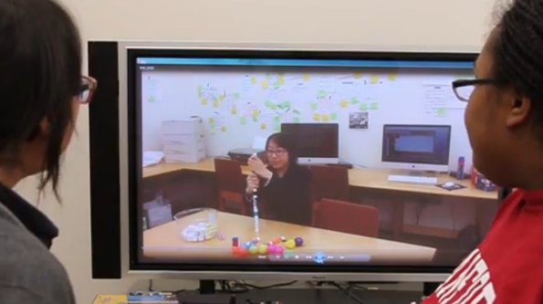
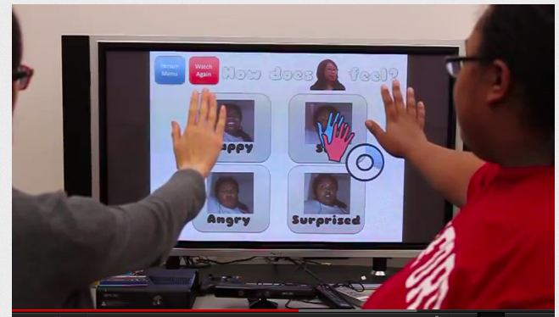
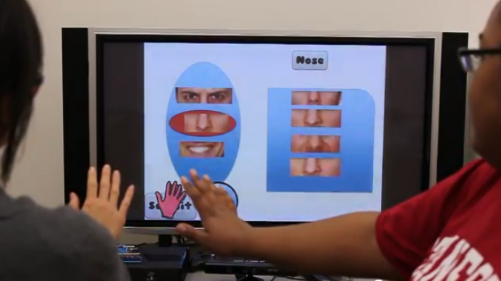
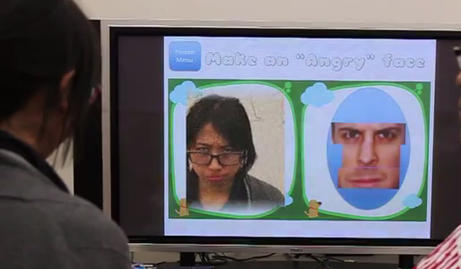
2nd Video Prototype
Notes:
Anna
After iterating on our first idea, we developed a second video prototype. The main changes in this prototype were:
Use of video of real people instead of cartoon scenarios
Additional forms of expressing the emotion – taking a picture of yourself, building the facial expression
Designed for therapist facilitation instead of another peer
The main flow of the activity was:
Select a video
Watch video
Answer the question “How do you think __ feels?”
Buidling a facial expression for that emotion
Taking a photo of your own face showing that emotion
--------
http://www.youtube.com/watch?v=SdbgAEY3zh0
Affordances
Embodied experiences
Motor coordination
Full body tracking

Slide 13
2nd Video Prototype
Feedback / Results
Good idea, but is this really leveraging the affordances of Kinect?
?
Notes:
After presenting this, people seemed to think it was a good idea. One question, however, was whether or not we were really leveraging the unique affordances of the Kinect? Our interface was very heavy on hand movement to make menu selections.

Slide 14
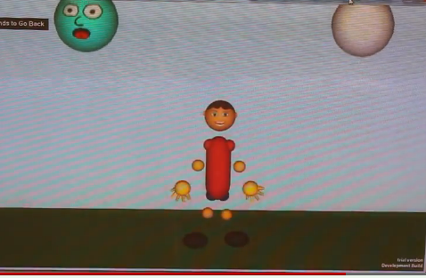
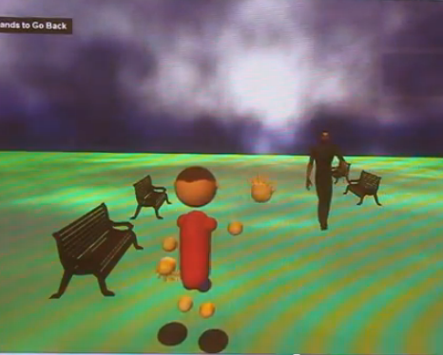
Me.Mu
Falling Faces
Hello Park
Notes:
Anna
So we had to face the harsh reality that our idea didn’t make compelling use of Kinect, and decided that we wanted to come up with something that did. After exploring more ideas we came up with a toolkit-of-mini-games approach and prototyped two activities after initial vetting from the therapists we were working with. One is called falling faces and the other is hello park. After iterating these multiple activities, we came up with the current solution which we will show in this video hich we have refined multiple times since coming up with the concept.
We will show the actual game play in a video, but in the first game (called Falling Faces), the player has to control the avatar to touch only the objects with faces. In the second game (called Hello Park), the player controls the avatar to practice waving.
We went back to the therapists to show them a video of our functional prototypes, and they were generally impressed and liked it a lot. More than one commented though that it may be too basic for most of the kids they currently work with. In response to this we added two more levels for the Falling Faces game. We were also referred to the Pacific Autism Center for Education (PACE), who have been amazing to work with in helping us test our project.
-------
http://youtu.be/yDzNTPgP85U
We went back to brainstorming and came up with suite of mini-games approach.

Slide 15
[Video Removed From File]
Notes:
Anna
So now we would like to show a video walkthrough of the current games.
Life-like situation
Exposure therapy
Motor coordination and body awareness
Embodied learning
Toolkit approach

Slide 16
Learning Theories for Me.Mu
Embodied Learning
Joint Media Engagement
Social Thinking
Notes:
Anna
Looking back at Me.Mu we found that there are three primary learning theories that underlie the games.
Embodied Learning: the idea that learning is facilitated through our bodies interacting in real time and real space (e.g. learning how to walk)
We teach how to wave to people repetitively so that the gesture can become ingrained and automatized
Activities that encourage movement helps learners get in touch with their bodies and may make them better prepared for learning social body language (i.e. occupational therapy benefits)
JME
During game play the therapists can help guide the attention of the students; without this facilitation it is very difficult for many of the kids to focus on their own
For example during Hello Park, while waiting for James to appear the students and therapists often engaged in conversation about the situation
Social Thinking
Explicit instruction in thinking in social situations and awareness of thoughts and emotions, in contrast to purely behavioral reinforcement to certain stimuli
Kinect waving game helps kids practice the physical component of greetings and gets them to realize the importance of that aspect in communication
The falling faces is a movement-focused activity just to help with motor coordination, while introducing facial emotions – it also helps them to increase processing speed of faces so they can think less about recognizing the emotion and more on what it means

Slide 17

Emotionary is an emotion diary to facilitate awareness of emotions in context through scaffolded reflection.
Notes:
Hain Lee
[0:30]
So now we’ll be switching gears to talk about our other subproject called emotionary. ”Emotionary is an emotion diary tool for iPad to facilitate awareness of emotions in context through scaffolded reflection.”

Slide 18
Notes:
Hain-Lee
[0:30]
As for why we also did an iPad app, we can speak more about during the Q&A if people are interested. But for now I’ll just say that it actually evolved from our early idea that we had for the kinect.
As we mentioned before, that idea didn’t take advantage of Kinect’s affordances. But instead of abandoning that concept of having students practice expressing emotions, which therapists thought was good, we thought it might be well suited for a tablet.

Slide 19
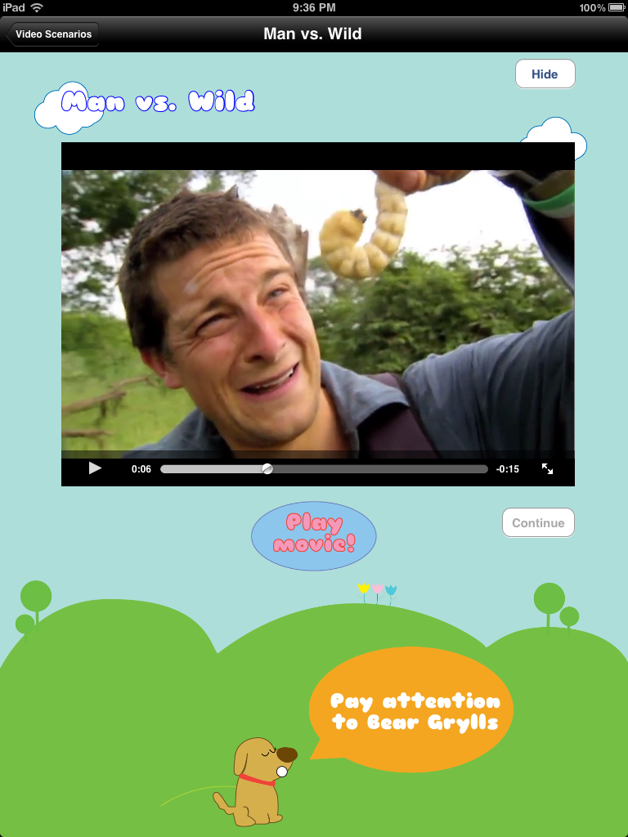
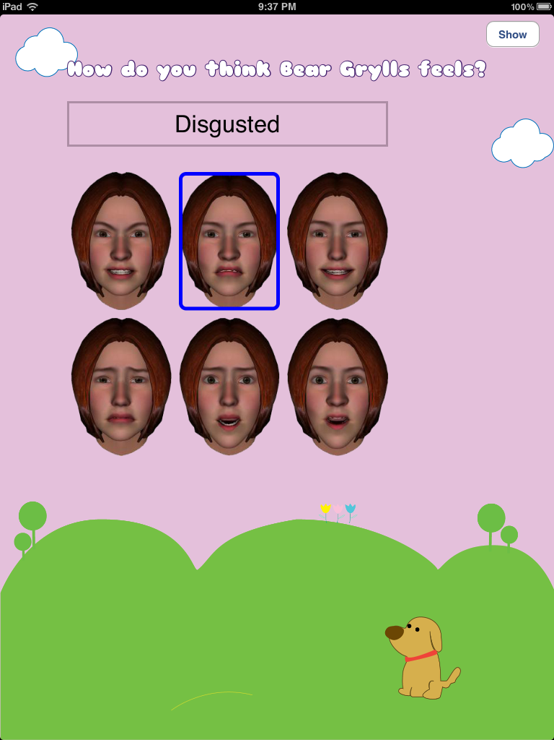
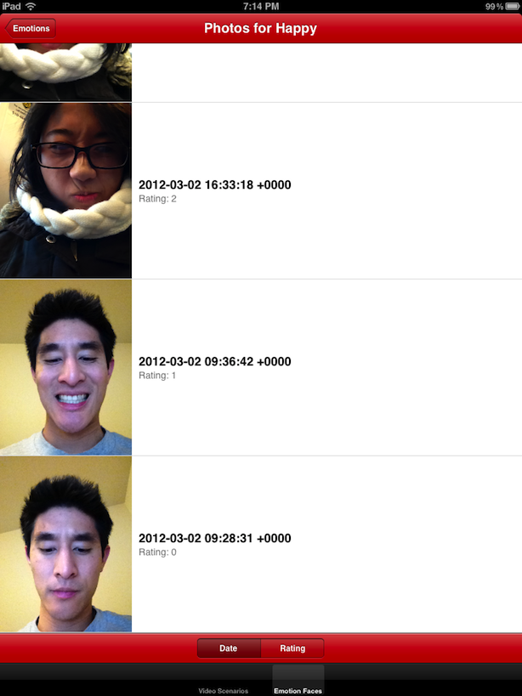
Emotionary v.0
Notes:
Hain-Lee
[1:00]
Our first prototype was pretty much a direct translation from our video prototype to the iPad – you watch a video, select which emotion was portrayed, and take a photo of yourself which gets stored.
We user tested this in two places, and although the feedback was generally positive, we weren’t quite content with the general experience. The reason is because video is already used in many existing solutions and this was not really using it in a unique way. We wanted to come up with something that was a little more novel.
------
More on why we pivoted; justification for how video/animations is commonly used already
Social story applications, video modeling apps
Therapists managing youtube video lists, with some guided questions
Observed use of video – frequent pausing to ask questions at particular points in the video; converting this to an app is rigid and cumbersome; why complicate it beyond simply playing/pausing?
Also may detract from the dialog that therapists typically want to facilitate (e.g. the e-book study conducted by cooney center)
Was it really actually adding anything from existing solutions that they have – they already go through youtube and stop/pause the video and ask questions. It would only be useful for very inexperienced therapists who don’t know what questions they should be asking. However, we are not experts in defining those types of questions and those who are…already have extensive material and we would just be “technology-ing” it

Slide 20
Strengths of Emotionary v.0
Emotions in context
Engagement with camera
Documenting progress
Can we design something different that still keeps these strengths?
Notes:
Hain-Lee
[0:30]
At the same time, we wanted to preserve the really good and effective aspects – showing emotions in context, being able to practice facial expressions, and documenting progress of facial expressions. So we asked ourselves if we could design something different that still keeps these strengths?

Slide 21
[Live Demo]
Notes:
We think that we’ve done that with Emotionary, which as I said before, is an emotion diary tool. So now we’ll do a live demo of the app.
[2:00]
[included screenshot slides as backup]
First thing to do is select student: Designed to be installed on the therapist’s iPad and intended use-scenario is for one-on-one sessions
If we tap on New Entry, the first prompt for the child is to select the emotion he/she is feeling
In the second step, they use the camera to practice making a facial expression that matches the emotion
In addition, they need to express why they feel that way, either by making an audio recording, including another picture, or typing a response; multiple options were provided for flexibility (a student who is nonverbal could type instead)
Creating an entry is pretty fast - an example of how this might fit in therapy is that a student could create an entry at the beginning and end of a one-on-one session
Here you can view all the entries for the particular student, so another exercise could be reviewing past entries with the student to reinforce understanding of emotions
With more and more entries we could do potentially interesting things like showing a child’s emotional state over time

Slide 22
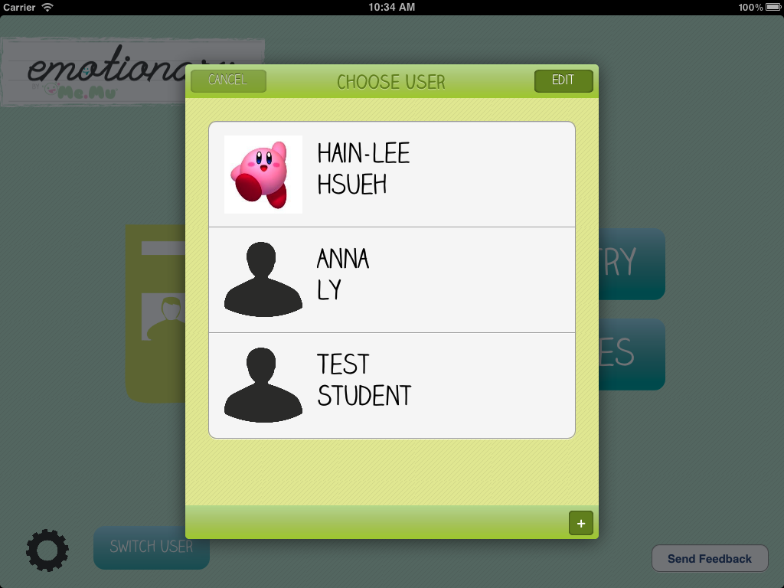
Notes:
Designed for therapists who often work with multiple kids

Slide 23
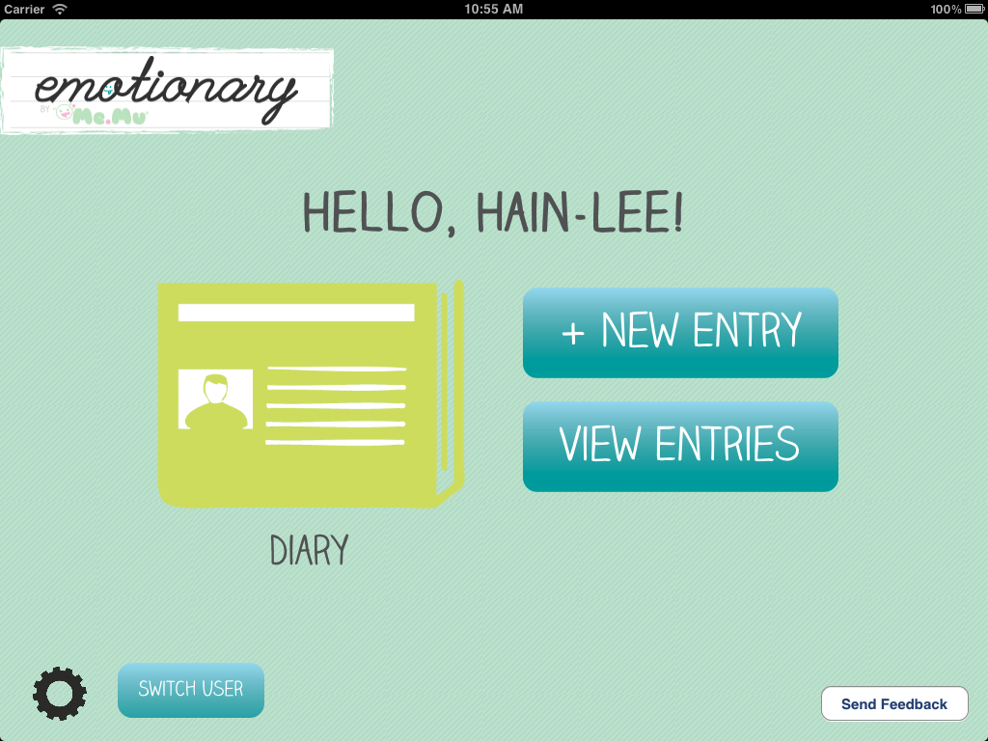

Slide 24
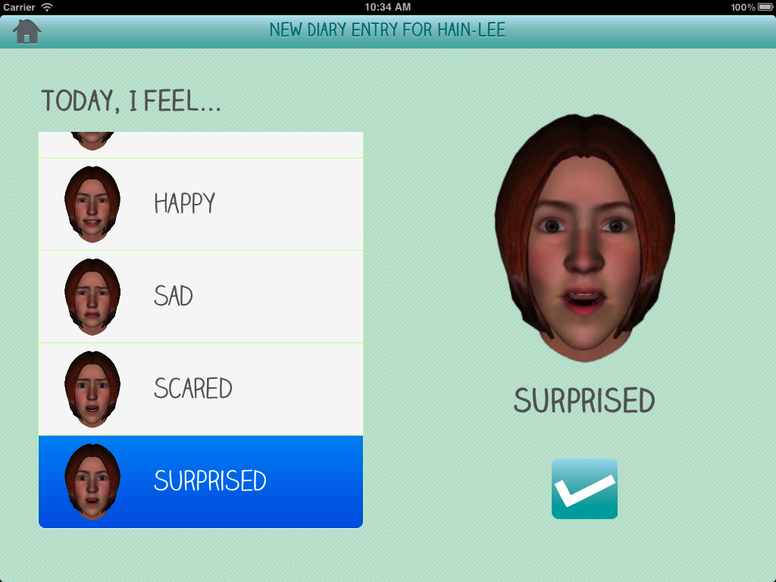

Slide 25
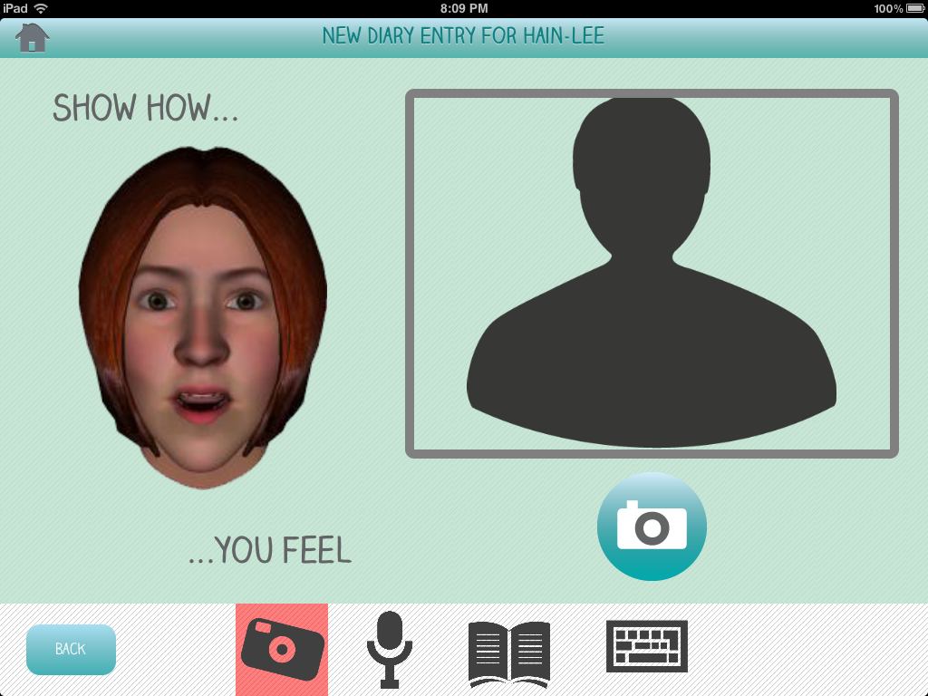

Slide 26
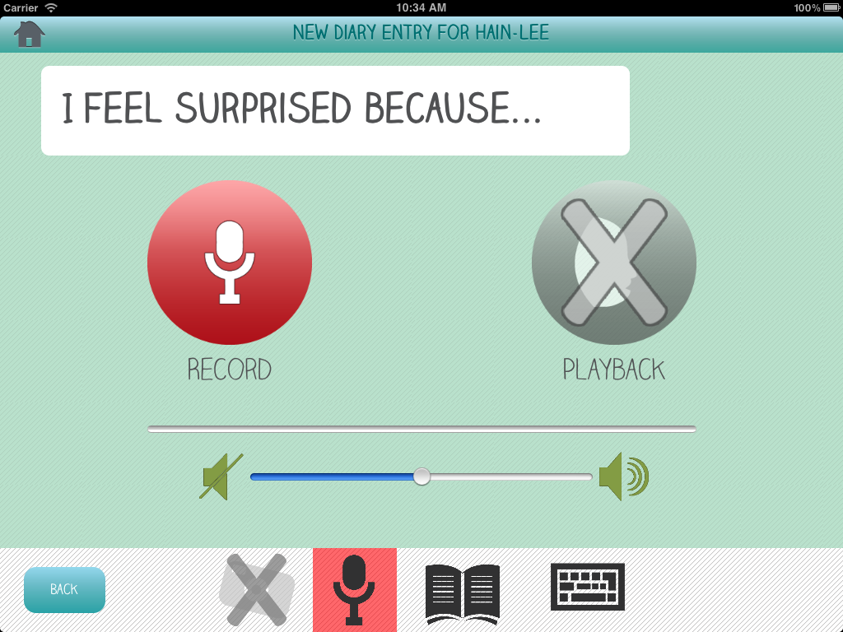

Slide 27
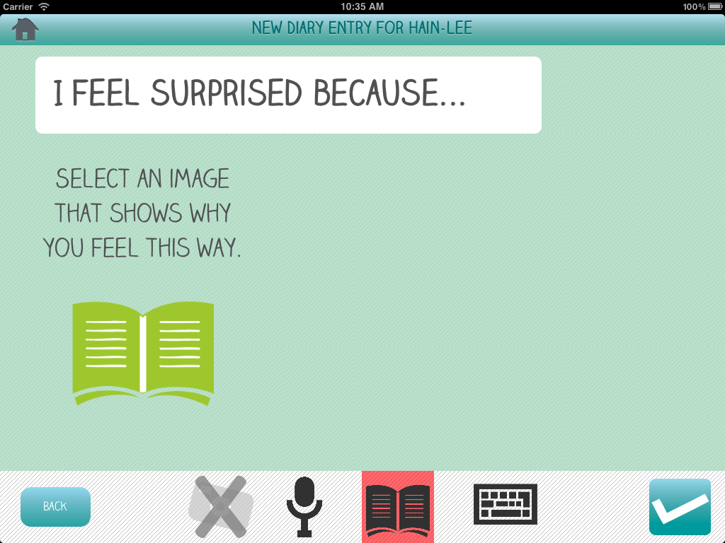

Slide 28
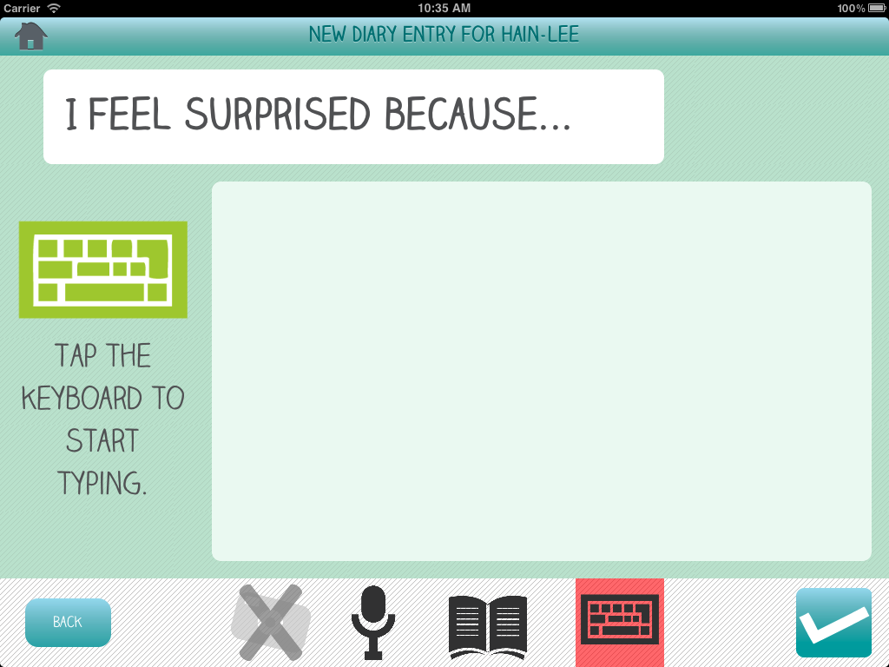
Notes:
Not all forms of responses are required – an attempt to make this usable for students who are nonverbal. If they can’t type, it could be possible to construct stences using an AAC app and paste them in.

Slide 29
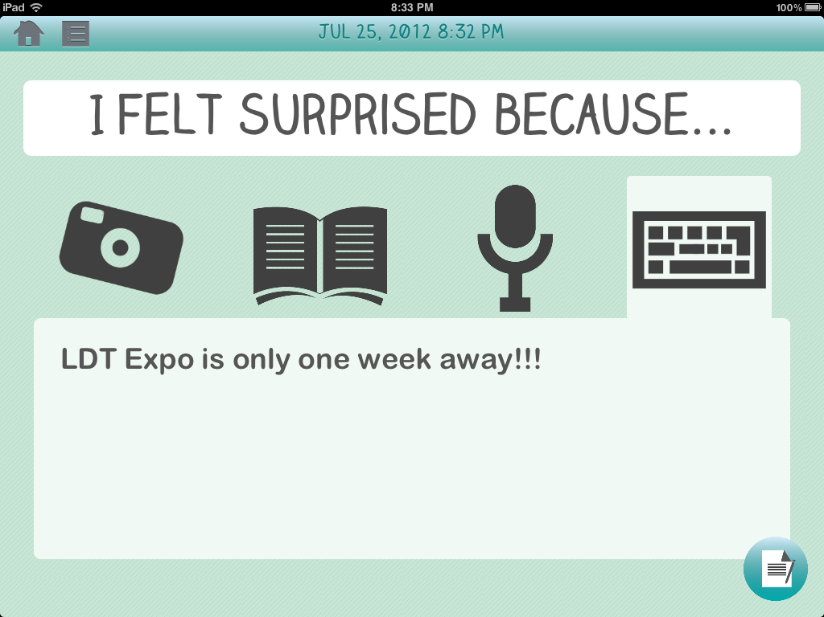

Slide 30
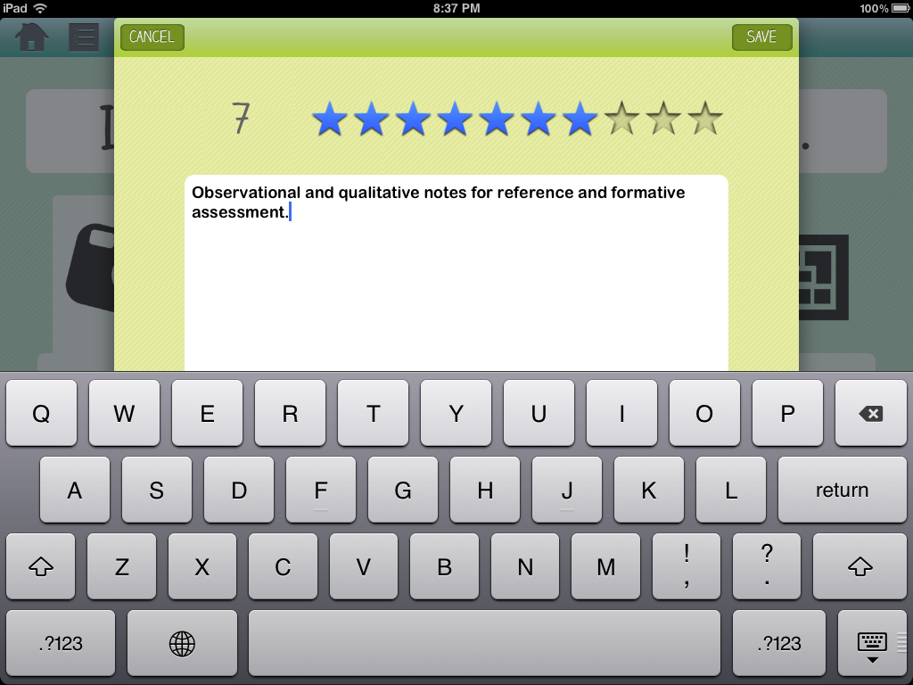

Slide 31
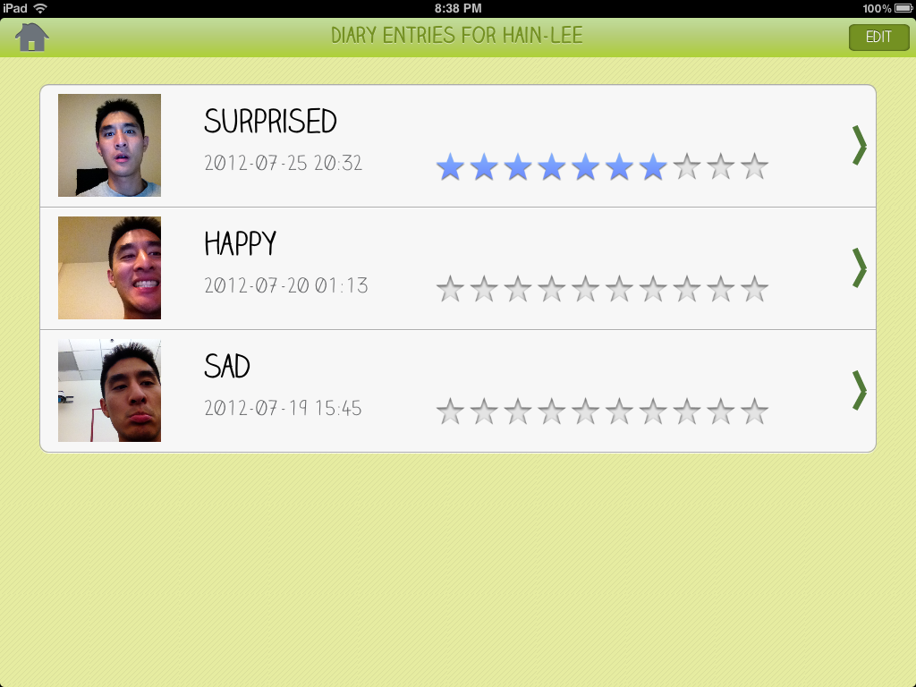

Slide 32
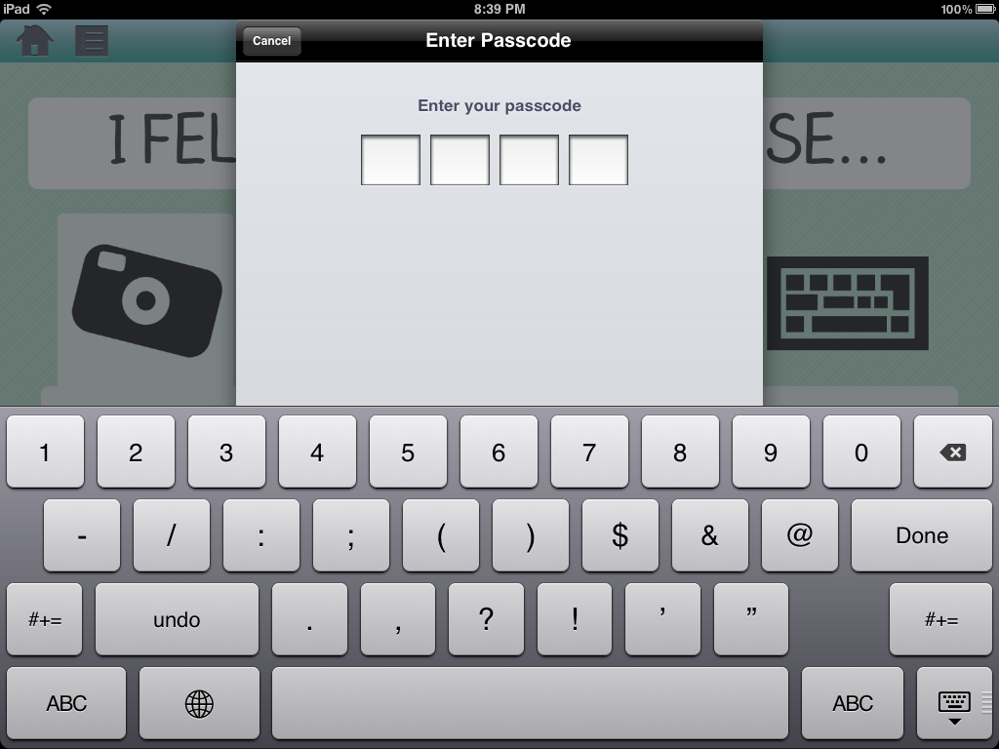

Slide 33
Learning Theories for Emotionary
Joint Media Engagement
Social Thinking
Vygotskian social development
Notes:
HL
[0:45]
After developing Emotionary we found that it aligned well with with JME, social thinking, and with Vygotsky’s theory of social development which emphasizes the importance of the learner’s environment in cognitive development (whether it’s a person, a tool, or experiences).
The app attempts to guide the learner through the challenging process of reflection by framing each diary entry as two short prompts – namely “How do you feel” and “why do you feel that way?”
In addition, learners are encouraged to leverage the socio-cultural context of their lives to construct a deeper understanding of emotions. They practice extracting contextual cues from personal experiences, rather than external hypothetical scenarios.

Slide 34
Learner Studies
Short informal studies at the
Pacific Autism Center for Education
(PACE)
Notes:
HL
[0:20]
We conducted learner studies for both Me.Mu and Emotionary in collaboration with the Pacific Autism Center for Education. A therapist and a teacher volunteered to pilot our solutions with several of the adolescent students over the course of a week.

Slide 35
Learner Study Data – Me.Mu
9 students
1-3 sessions
4 days
TOTAL STUDENTS
>1 SESSIONS
IMPROVED SCORES
100% of those with >1 sessions
78% of total
Notes:
AL – GENERAL GENERAL GENERAL GENERAL CLAIMS
MeMu was used with a total of 9 students over 3 sessions. For each student, scores were recorded on their performance for each of the levels in Falling Faces, in addition to general observation notes for Hello Park.
Obviously, it’s very difficult to make any kind of claims on learning over such a short period of time, especially with our target learner group and social skills. But from a raw scores perspective, 100% of students with multiple sessions improved in scores over time.
-----------------
Kinect
better suited for students who can have moderate focus/attention to the screen; some students were constantly shifting their eye gaze around the room
although students could be verbally and physically prompted, it's not clear if they were coordinating to the game or just imitating the staff's instructions
some students at least were able to complete the game with less prompting in subsequent sessions
colors of the faces did not seem to distract, as performance on b/w faces was roughly the same as with color, indicating that attention was being made towards the actual faces and not the colors; no mention of the B/W nature of the game in the videos
For Hello Park, at least one student could successfully learn a more proper wave and correct their own wave by watching the staff model it. They could correctly apply it to the game and get visual feedback.
Students could match who they needed to wave to based on the portrait of the person (key characteristic was yellow shirt)
Engagement
many students were eager to get their turn
students clapped and cheered for each other, which facilitated laughter and smiling and clapping from the players
even students who were not playing were engaged in watching their peers play the game
Hello Park was a fun way for them to practice waving - more smiles and verbal activity (e.g. James! James! No, that's not James...C'mon James!...sorry man"). They were pretend talking to the people on the screen.

Slide 36
Me.Mu Findings
Learning
Falling Faces – colors of the faces not a distraction
Hello Park – one student able to correct his wave
Less prompting in subsequent sessions
Engagement
Students clapped, cheered, and volunteered
Students talked to the characters on screen
Repetitive nature of “Hello Park” was appealing
Notes:
AL
Some learning-related findings we could extract is that for Falling Faces there was no clear difference in scores between the second level with colors and the third level with black/white faces. This seems to suggest that students were actually paying attention to the facial expressions and not the color. Also, initially most students required lots of verbal and/or physical prompting; but after the first session some students completed the games with less prompting, which may indicate the students are at least learning how to navigate the game and understand the rules.
There was, however, a lot of evidence of engagement
For Hello Park, at least one student could successfully learn a more proper wave and correct their own wave by watching the staff model it. They could correctly apply it to the game and get visual feedback.
Hello Park was particularly favored – the repetitive nature of it may have appealed to the students, which is a good thing because it means they get more practice
Students were engaged as evidenced by watching their peers play, cheering for them, and cheering for themselves; pretend talking to the characters on screen
Although these are good things, it’s important to note that not all students were able to fully participate either because the game was confusing, or because they were unable to maintain focus on the screen.
-----------------
Kinect
better suited for students who can have moderate focus/attention to the screen; some students were constantly shifting their eye gaze around the room
although students could be verbally and physically prompted, it's not clear if they were coordinating to the game or just imitating the staff's instructions
some students at least were able to complete the game with less prompting in subsequent sessions
colors of the faces did not seem to distract, as performance on b/w faces was roughly the same as with color, indicating that attention was being made towards the actual faces and not the colors; no mention of the B/W nature of the game in the videos
For Hello Park, at least one student could successfully learn a more proper wave and correct their own wave by watching the staff model it. They could correctly apply it to the game and get visual feedback.
Students could match who they needed to wave to based on the portrait of the person (key characteristic was yellow shirt)
Engagement
many students were eager to get their turn
students clapped and cheered for each other, which facilitated laughter and smiling and clapping from the players
even students who were not playing were engaged in watching their peers play the game
Hello Park was a fun way for them to practice waving - more smiles and verbal activity (e.g. James! James! No, that's not James...C'mon James!...sorry man"). They were pretend talking to the people on the screen.

Slide 37




Learner Study Data - Emotionary
36 entries
6 students
3 days
TOTAL
ENTRIES
PHOTO
TEXT
32/36 ☺
AUDIO
36
97%
72%
50%
Notes:
HL
[0:30]
Emotionary was used by a teacher and other staff with 6 students over 3 days. Each student created 1-3 entries each day. This is just a breakdown of the frequency of response types – almost all the students include a photo of the student. Also, 32/36 entries were tagged as happy, which is a good thing for PACE ☺
---------------------------------------
Most of the time when audio and text are provided, the audio is a recitation
32 happy / 1 angry / 3 sad
Specific reasons
the bus
sitting on the teetertotter
going to 7-11
going to costco
because it's monday/tuesday
room 4 is cool sweet Silvia and rosie are nice
it's lunch
my dad is in town
i work so hard
i bought a welch grape juice
went to the city of santa clara
we are going to full circle farm. When i am at full circle farm like to pick up weeds
we did art
Vague reasons
had fun
i feel hyper
i woke up like that
just am
f the text.

Slide 38
Emotionary Findings
Learning
Some students able to connect emotions with specific events
Responses typically a short sentence
Engagement
Students excited to have their turn with the iPad
Notes:
HL
In terms of learning, it was clear that some students were able to express themselves clearly and others were not. For the ones who could, they were able to articulate specific reasons for being happy – e.g. going on a trip to the farm or the supermarket.
However the responses were typically very short – just a brief sentence. It would be interesting to see if over time, students could elaborate more on their emotions.
In terms of engagement, students were eager to use the iPad as a way to express themselves.

Slide 39
Acknowledgements
Thank you to….
Pacific Autism Center for Education (pacificautism.org)
Associated Learning & Language Specialists (allsinc.com)
Developmental Pathways (developmentalpathways.com)
All the parents, therapists, & students who tested and supported our project!
Microsoft, for awarding us a Kinect
Financial support from Mr. Reece Duca
Notes:
Lastly we wanted to say thank you to the various individuals and organizations who spent much time and effort meeting with us, testing our ideas, giving us feedback, and really teaching us about what it’s like to work with individuals on the spectrum.
We also want to thank all of you for coming and listening to us. We hope our presentation was interesting and now we’d like to give you the opportunity to ask any questions.
Questions
Could you see these tools being used in regular therapy? Why or why not?
How would you assess the effectiveness of these tools?

